Slide 1
Using AI to Validate Carbon Containment in Illinois Basin Machine Learning Challenge
Insights Inc

Slide 2
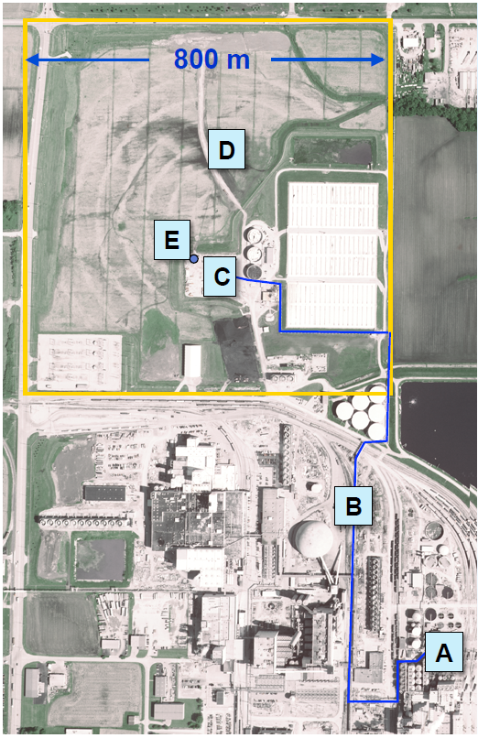
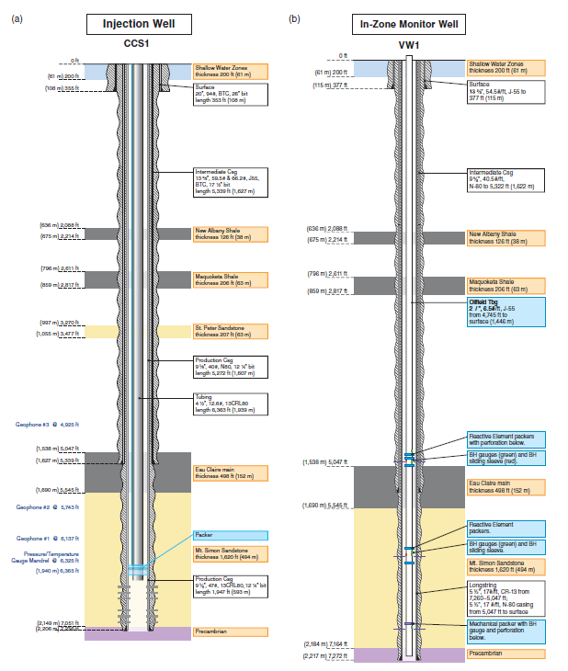
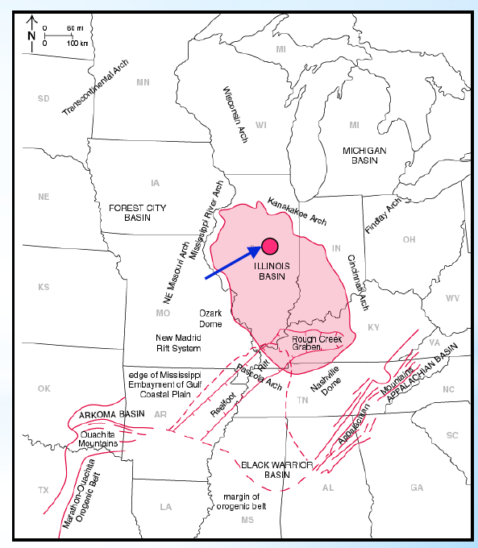
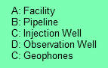
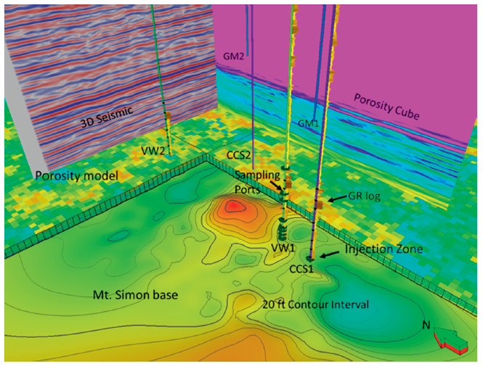
Background & Objective
Carbon Dioxide (CO₂) released from ethonal production at the ADM (Archer Daniels Midland) Company’s plant was compressed, dehydrated and injected into the Mt. Simom Sandstone
Mt Simon Sandstone is a saline aquifer located in the Illinois Basin and is approximately ~7,000 ft deep
Over three years (Nov-2011 to Nov-2014), ~1000 tonnes/d of CO₂ was injected into the reservoir
Cumulatively, 999,215 tonnes of supercritical CO₂ was injected and has been geologically stored in Mt Simon Sandstone
The injection and verification wells that are ~700ft apart are drilled downdip into the Mt Simon Sandstone
The wells were equipped with downhole sensors to monitor pressure and temperature at various depths of interest
The aim of this challenge is to use time series injection information and monitoring data on a carbon capture well to predict carbon capture well injection rates deltas
Source: modified from Locke, 2012
Source: Bauer et al, 2019
Source: Bauer et al, 2019
Source: Bauer et al, 2019

Slide 3
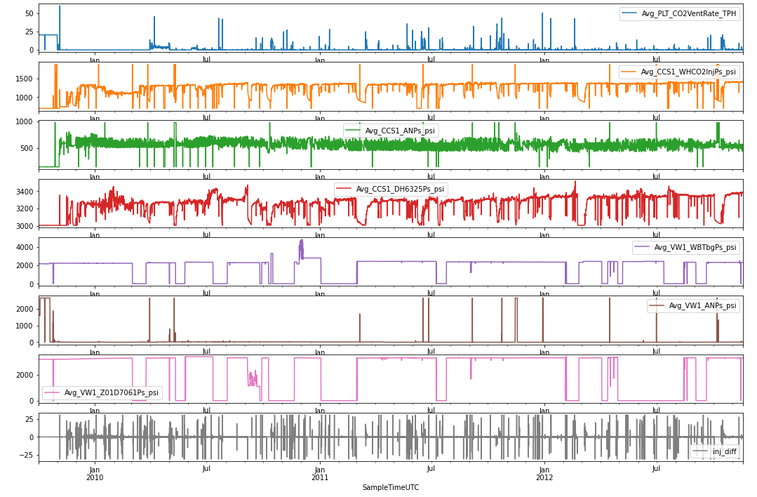
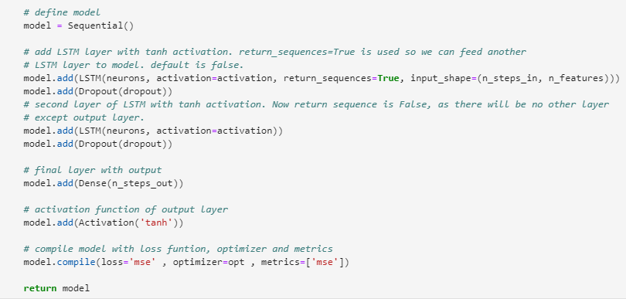
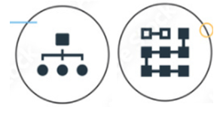
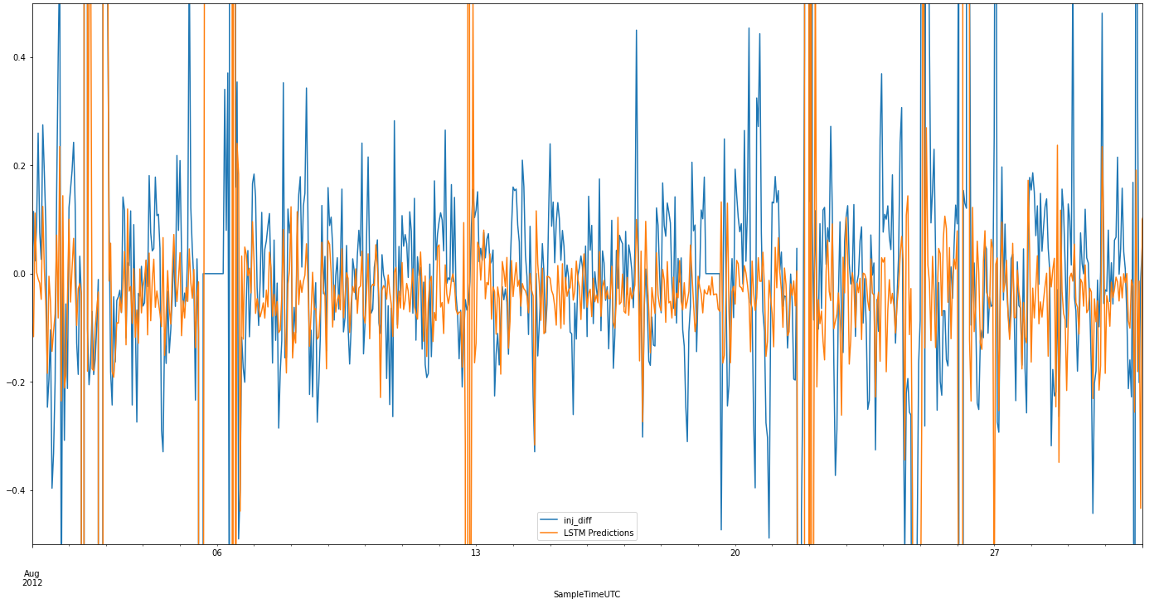
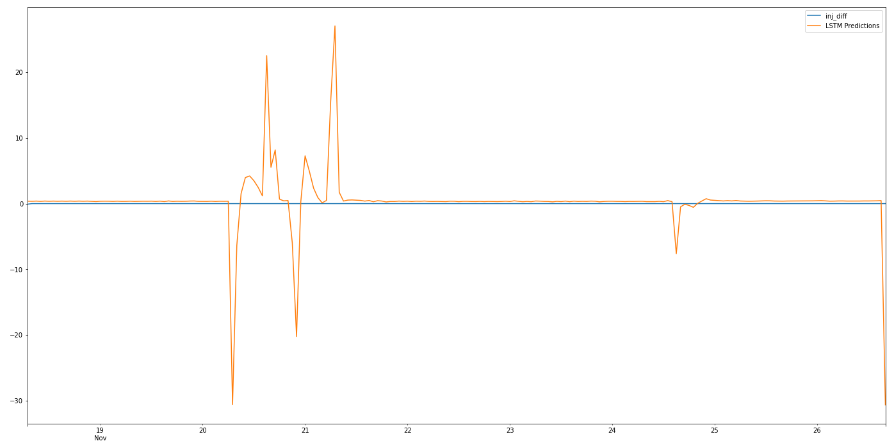
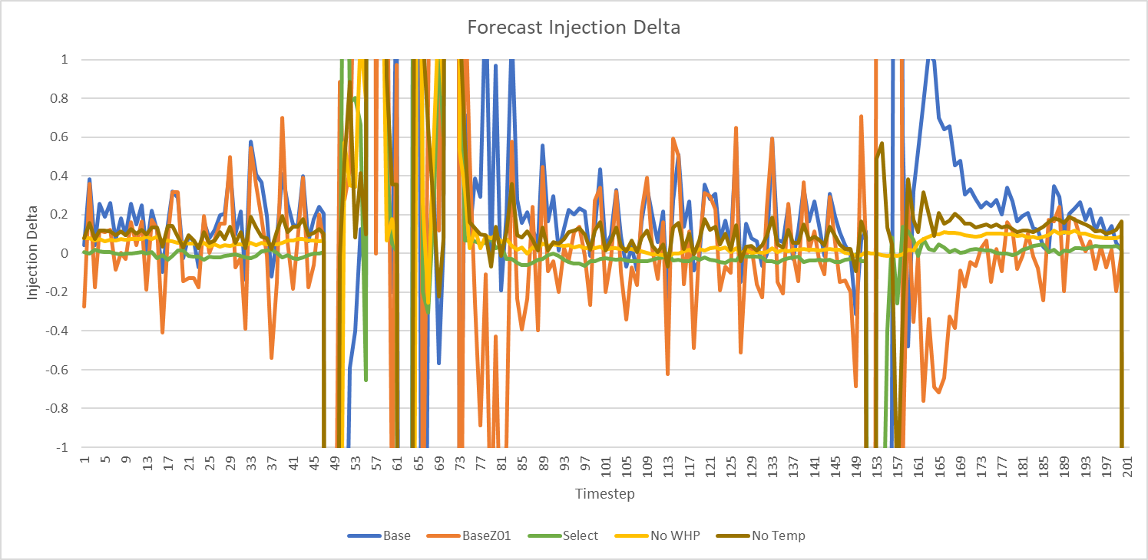
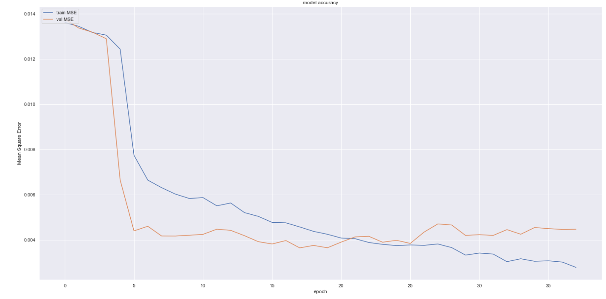
Methodology - Machine Learning
Model Training
Data Collection
Data Preparation/Cleaning
Model Selection - LSTM
As new data is collected, it will appended to the entire dataset and the model will re-trained stochastically (unseeded) for future prediction
Retrain model on full dataset, deploy on blind data set using unseeded model
Sensitivity runs on inputs and testing randomness
Model Deployment
Model Evaluation/Validation

Slide 4
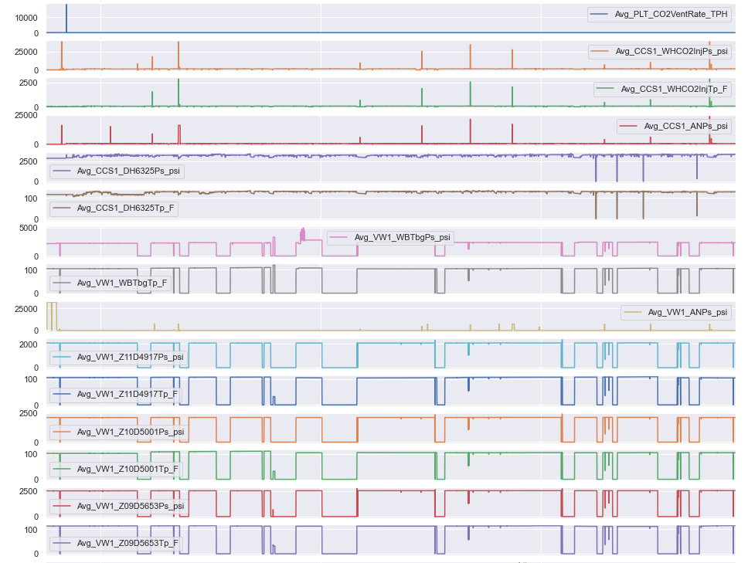
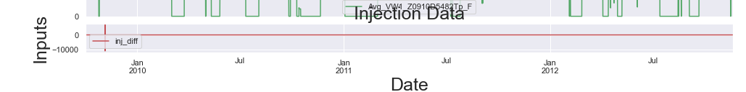
Data Orientation
Wealth of data available
Outlier presence
~25,000 psi WHP at injection well
0 psi downhole gauge pressure
Outliers likely caused by erroneous sensor readings/ reporting
Observation that there are variables with similar trends – correlatability check required
Target variable base is 0 psi. Deviation would result in –ve or +ve differences

Slide 5
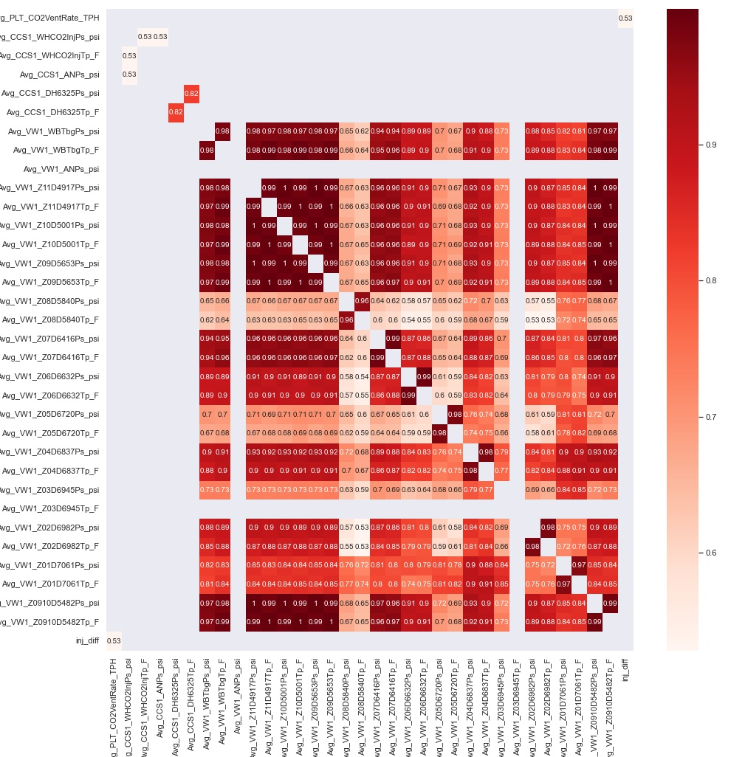
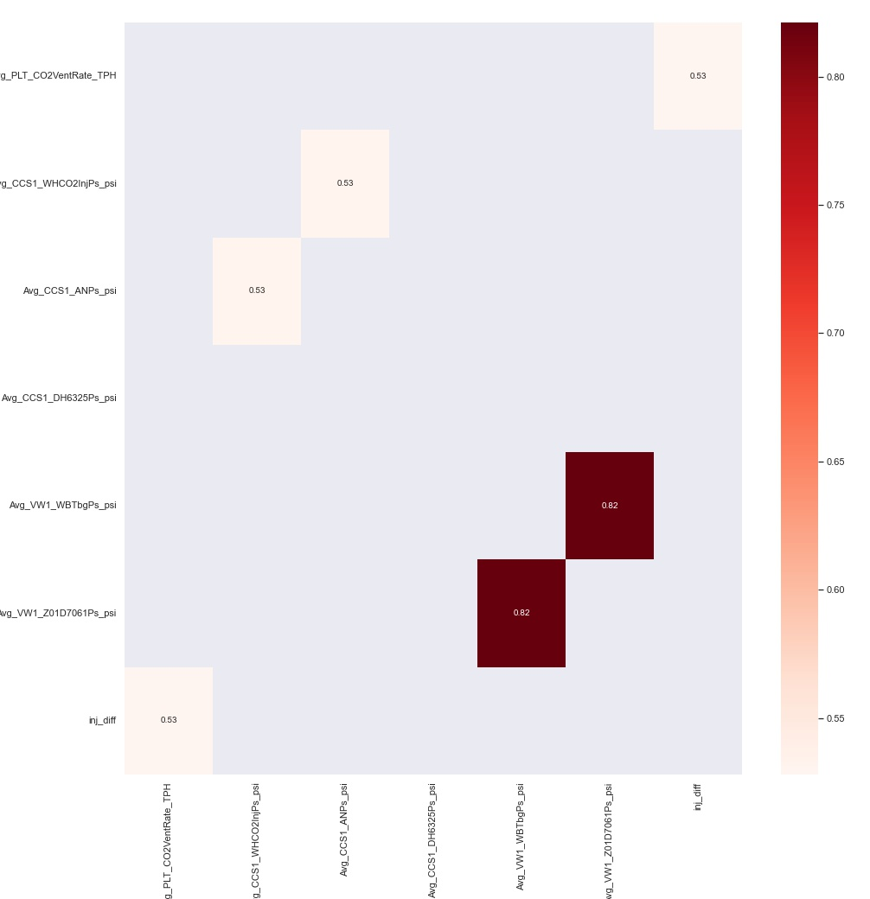
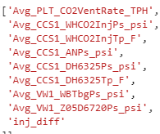
Data Preparation
Most variables are highly correlatable, with values of > 0.5
Retained only one variable from groups of highly correleatable variables.
Exceptions are made if variables are found from different sources e.g. tubing and reservoir pressure at the observation well
Excluding the target injection delta variable, six variables retained for the machine learning application.
A modified Z-score is used to remove the outliers.
A more lenient score is used for injection delta and CO2 vent rate due to the difference in the magnitude’s range
The zero values at the observation well sensors have been kept – this will be tested for removal during the sensitization stage

Slide 6
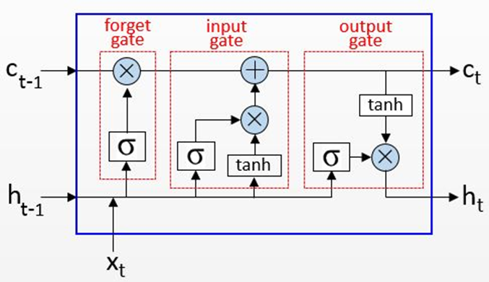
Long Short-Term Memory (LSTM) & Randomness
LSTM is a type of recurrent neural network (RNN)
Learns from previous outputs to provide better results the following time
Typical LSTM has 3 layers
Input gate which assigns weights based on the significance of different variables,
Forget gate to retain only useful information, and
Output gate which manages the information flow
Randomness
Machine learning models are stochastic in nature
Randomness is present in the LSTM network employed
Sensitivity runs on input parameters
Randomness controlled using a seed value – so that we reproduce the result if necessary
To see effect of input parameter
Model Deployment and Prediction
Deployed without a seed to make use of the randomness –
if the model is run again, it will not be able to re-produce the exact same result
Multiple runs may be different, but the results will be in range
the anomalies will be predicted
objective of the model met.
Note. By Rainardi, V., 2021, RNN and LSTM. Accessed at https://dwbi1.wordpress.com/2021/08/07/recurrent-neural-network-rnn-and-lstm/

Slide 7
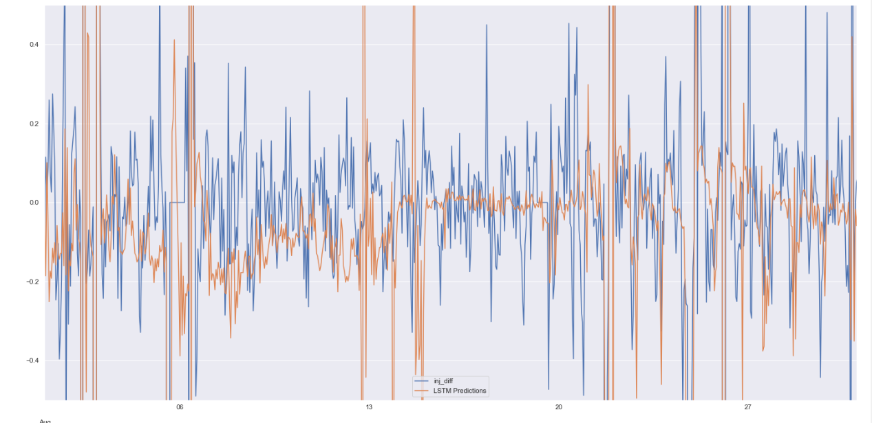
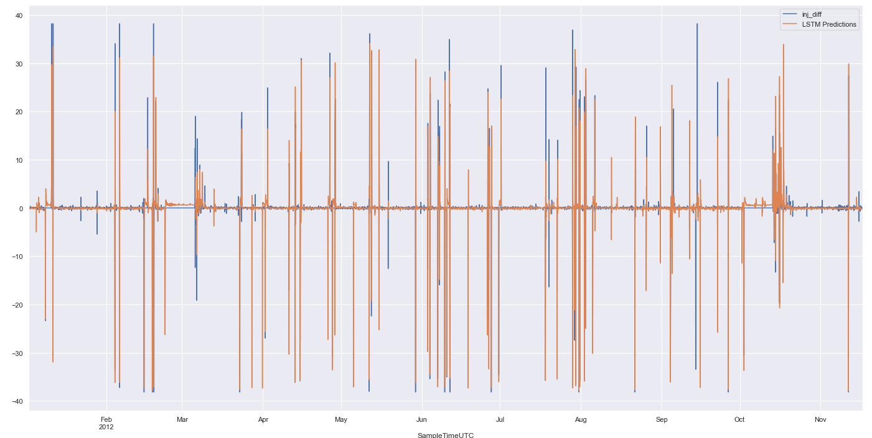
Model Validation
Able to match anomalies in injection delta
Able to mimic the small variations in the injection delta

Slide 8
Sensitivity Runs
Sensitivity runs on input parameters were performed using a single seed value of 2250.
Several sensitivities were run but only selected are displayed here
Best results (based on RMSE)
Scaling between -1 and 1
Use of DH sensor Z05 data with corrected values of 0
Use of temperature and whp sensors data
Z-score outlier replacement of 25, resulting inj_diff range between 30 and -30.
Vintage | Select | Base (0) | 4 | 12 | 9
Scaling | Y(-1,1) | Y(0,1) | Y(0,1) | Y(-1,1) | Y(-1,1)
VW DH Sensor | Z05 | Z09 | Z01 | Z05 | Z05
Injection WHP Sensor | Y | Y | Y | Y | N
Temp Sensor | Y | N | N | N | Y
Z-Score Inj_Diff | 25 | 20 | 25 | 25 | 25
VW Zero Values | No | Yes | No | No | No
Val RMSE | 1.55 | 1.75 | 2.20 | 1.90 | 2.01
Val R2 | 0.82 | 0.73 | 0.63 | 0.72 | 0.69

Slide 9
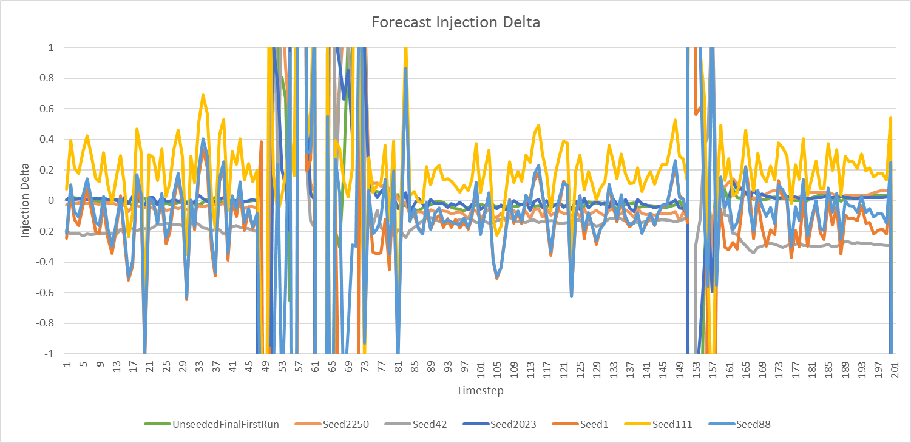
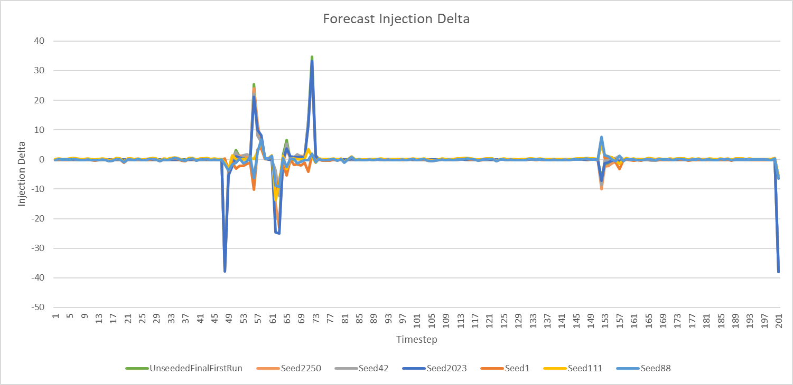
Randomness
Running with different seed values result in different results due to the stochastic nature of the model.
10 runs with various seed values were run and a selected six are displayed here to show the range in comparison to the first unseeded run
All runs can predict the anomalies however the signature of the minor differences varies
The RMSE and R2 values on the validation set is within a small range
Thus, to include randomness and to be unbiased, an unseeded model is selected for deployment
Seed Value | Unseeded | 2250 | 42 | 2023 | 1 | 111 | 88
Val RMSE | 1.73 | 1.55 | 1.69 | 1.69 | 1.64 | 1.87 | 1.70
Val R2 | 0.77 | 0.82 | 0.78 | 0.78 | 0.79 | 0.73 | 0.78

Slide 10
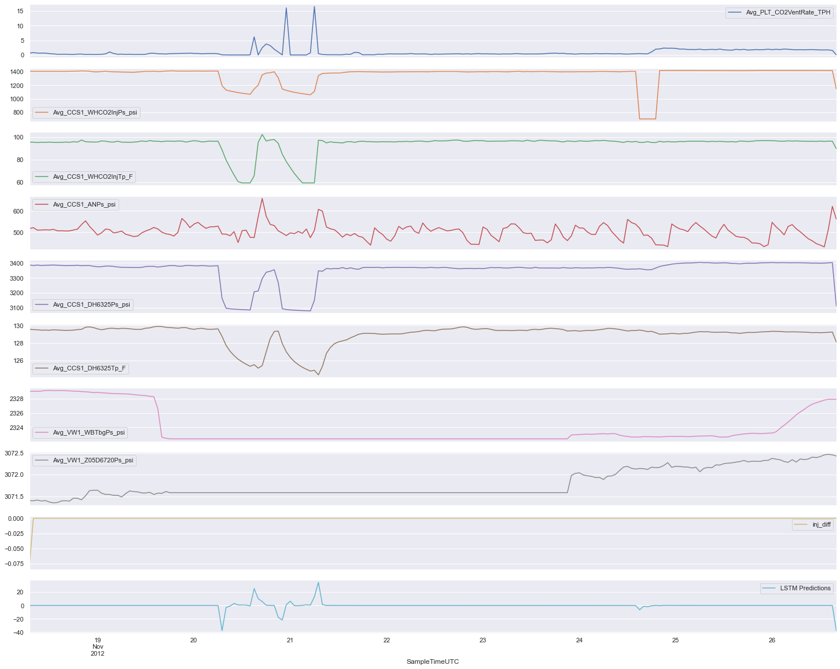
Predicted Injection Difference
Predicted models does well based on good RMSE and R2 scores on test and train data
Able to pick out large anomalies thus meeting the objective of the challenge
Also able to predict small variation in rate though might have a slightly different signature
Future recommendations for improvement:
Explore alternative models
Improved outlier removal / nan/zero replacements
Improve workflow to decrease runtime which will allow multiple set of runs creating an ensemble of models and taking the mean of the output
Inputs
Prediction

Slide 11
Thank you all!
Happy to share more about our algo and journey, feel free to reach out to us
Please keep this slide for attribution

